Slide 1
Website: Day 3

Slide 2
Features section

Slide 3
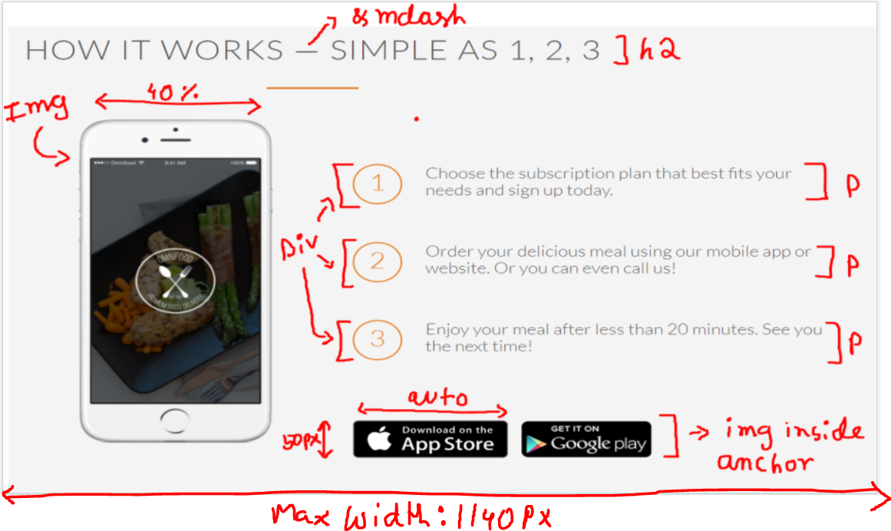
Features section

Slide 4
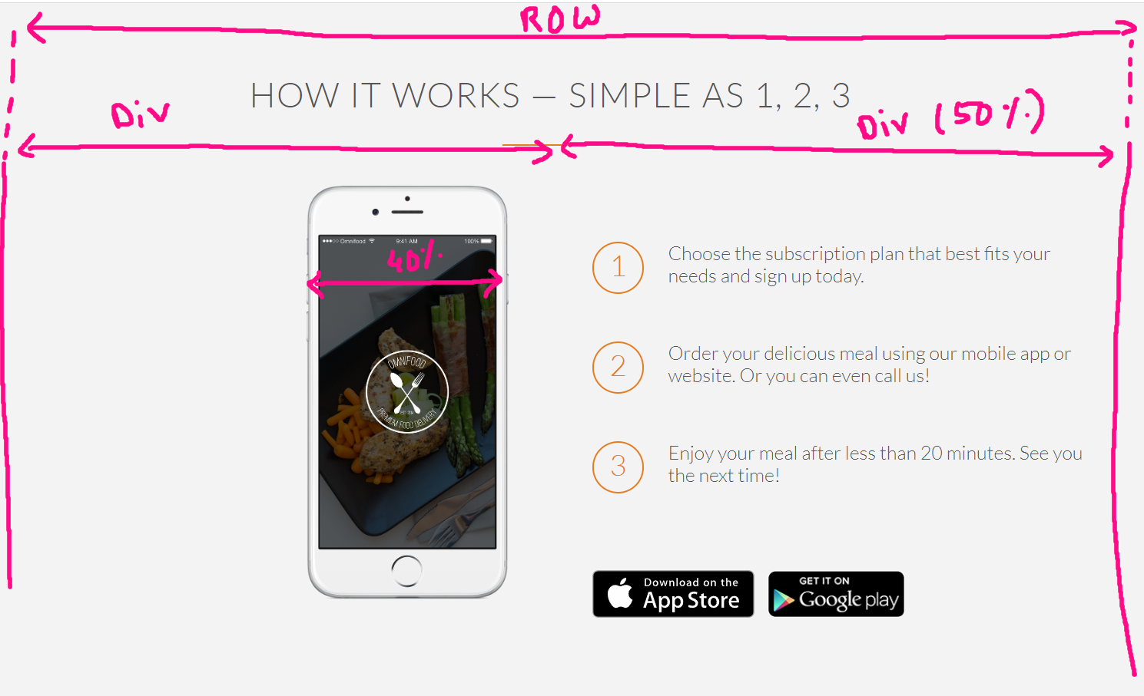
Features section

Slide 5
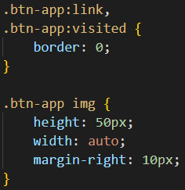
Features section
This is how I have implemented the buttons -

Slide 6
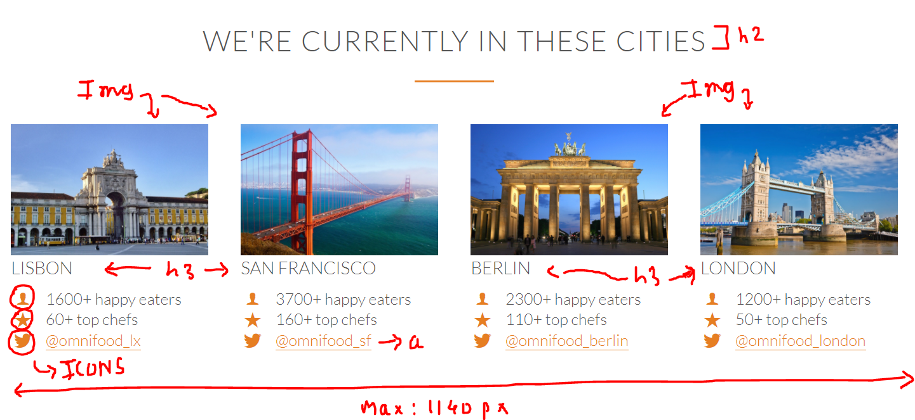
Features section
This is how I have implemented the buttons -

Slide 7
Features section
For the images, I did not fix the width to any specific number. You should let flexbox to take care of the width.
You can set the height to auto if needed.

Slide 8
Finish designing these sections.
All the best!

